Slide 1
PASCALE Projects
The Green Unicorn in Western Ukraine

Slide 2
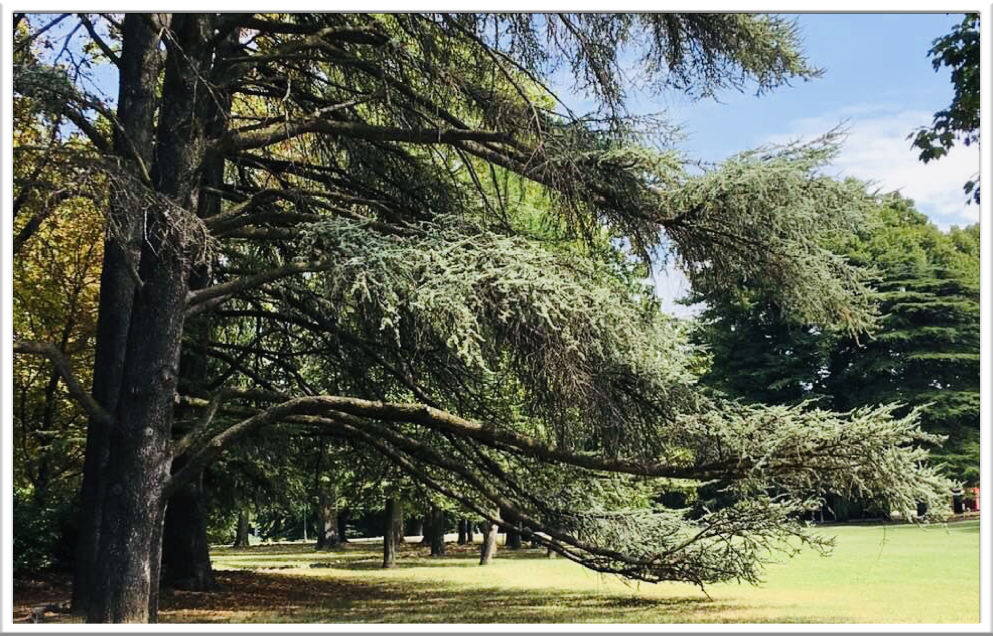

OUR CONCEPT
To create in Western Ukraine the green and innovative Unicorn of Renewable Energies and Natural Resources by a Sustainable Forest Management with the final goal to replicate the model all over Ukraine,Europe and worldwide.

Slide 3
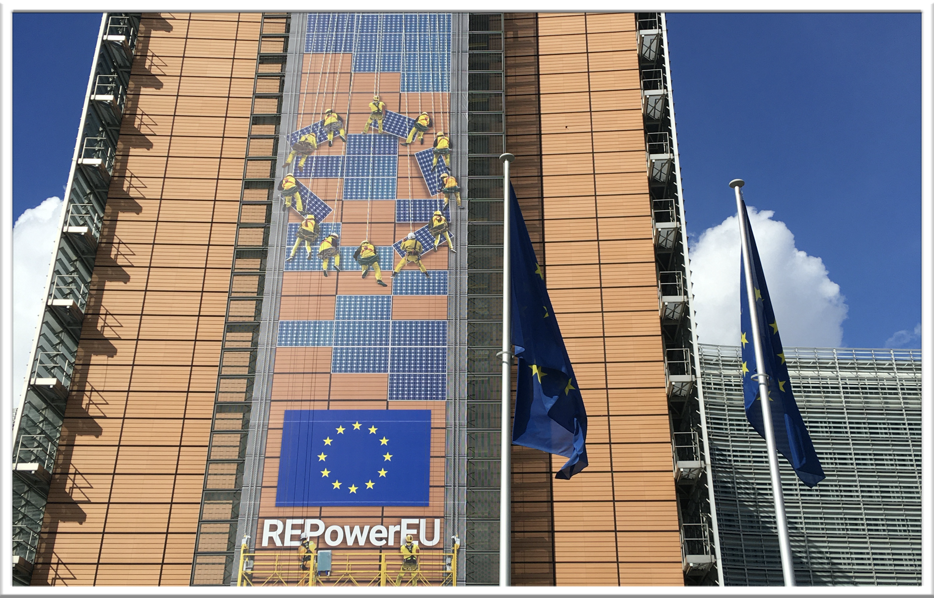
Our History-Western Ukraine-EU
PASCALE-PROJECTS.COM- With Representative Office in Brussels supports innovative industrial hubs located in western Ukraine via EUROPEAN FUNDINGS for CIRCULAR ECONOMY and bio-based materials

Slide 4
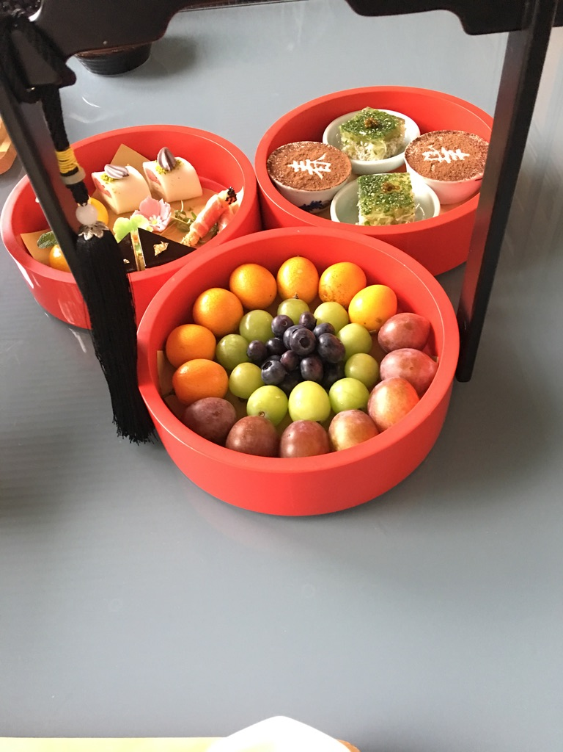

  PROJECT FOR UA RECONSTRUCTION —-BIOCHAR
Biochar (vegetal charcoal) is emerging as a strategic resource for Ukraine's green recovery, serving both the remediation of war-damaged soils and the development of a sustainable circular economy.
1. Post-War Restoration Applications
Ukraine is exploring the use of biochar to address environmental challenges caused by the conflict:
Soil Remediation: It is used for the adsorption of toxic metals and organic pollutants in territories affected by military operations.
Water Treatment: Recent studies have confirmed the effectiveness of activated carbons produced from local biomass for purifying wastewater and drinking water.
Carbon Sequestration: Biochar contributes to climate strategies by stably trapping in the soil, mitigating the environmental impact of emissions.
2. Agricultural and Forestry Sector
Given its nature as a soil amendment, biochar offers direct benefits to Ukrainian agricultural productivity:
Fertility Improvement: It increases water retention and reduces the need for chemical fertilizers, supporting crop growth in rural areas.
Residue Management: Local sawmills and farms can transform waste—such as sawdust, bark, and prunings—into a valuable resource, reducing landfill waste.
Animal Feed: Evaluations are underway regarding the use of biochar as a feed supplement.

Slide 5
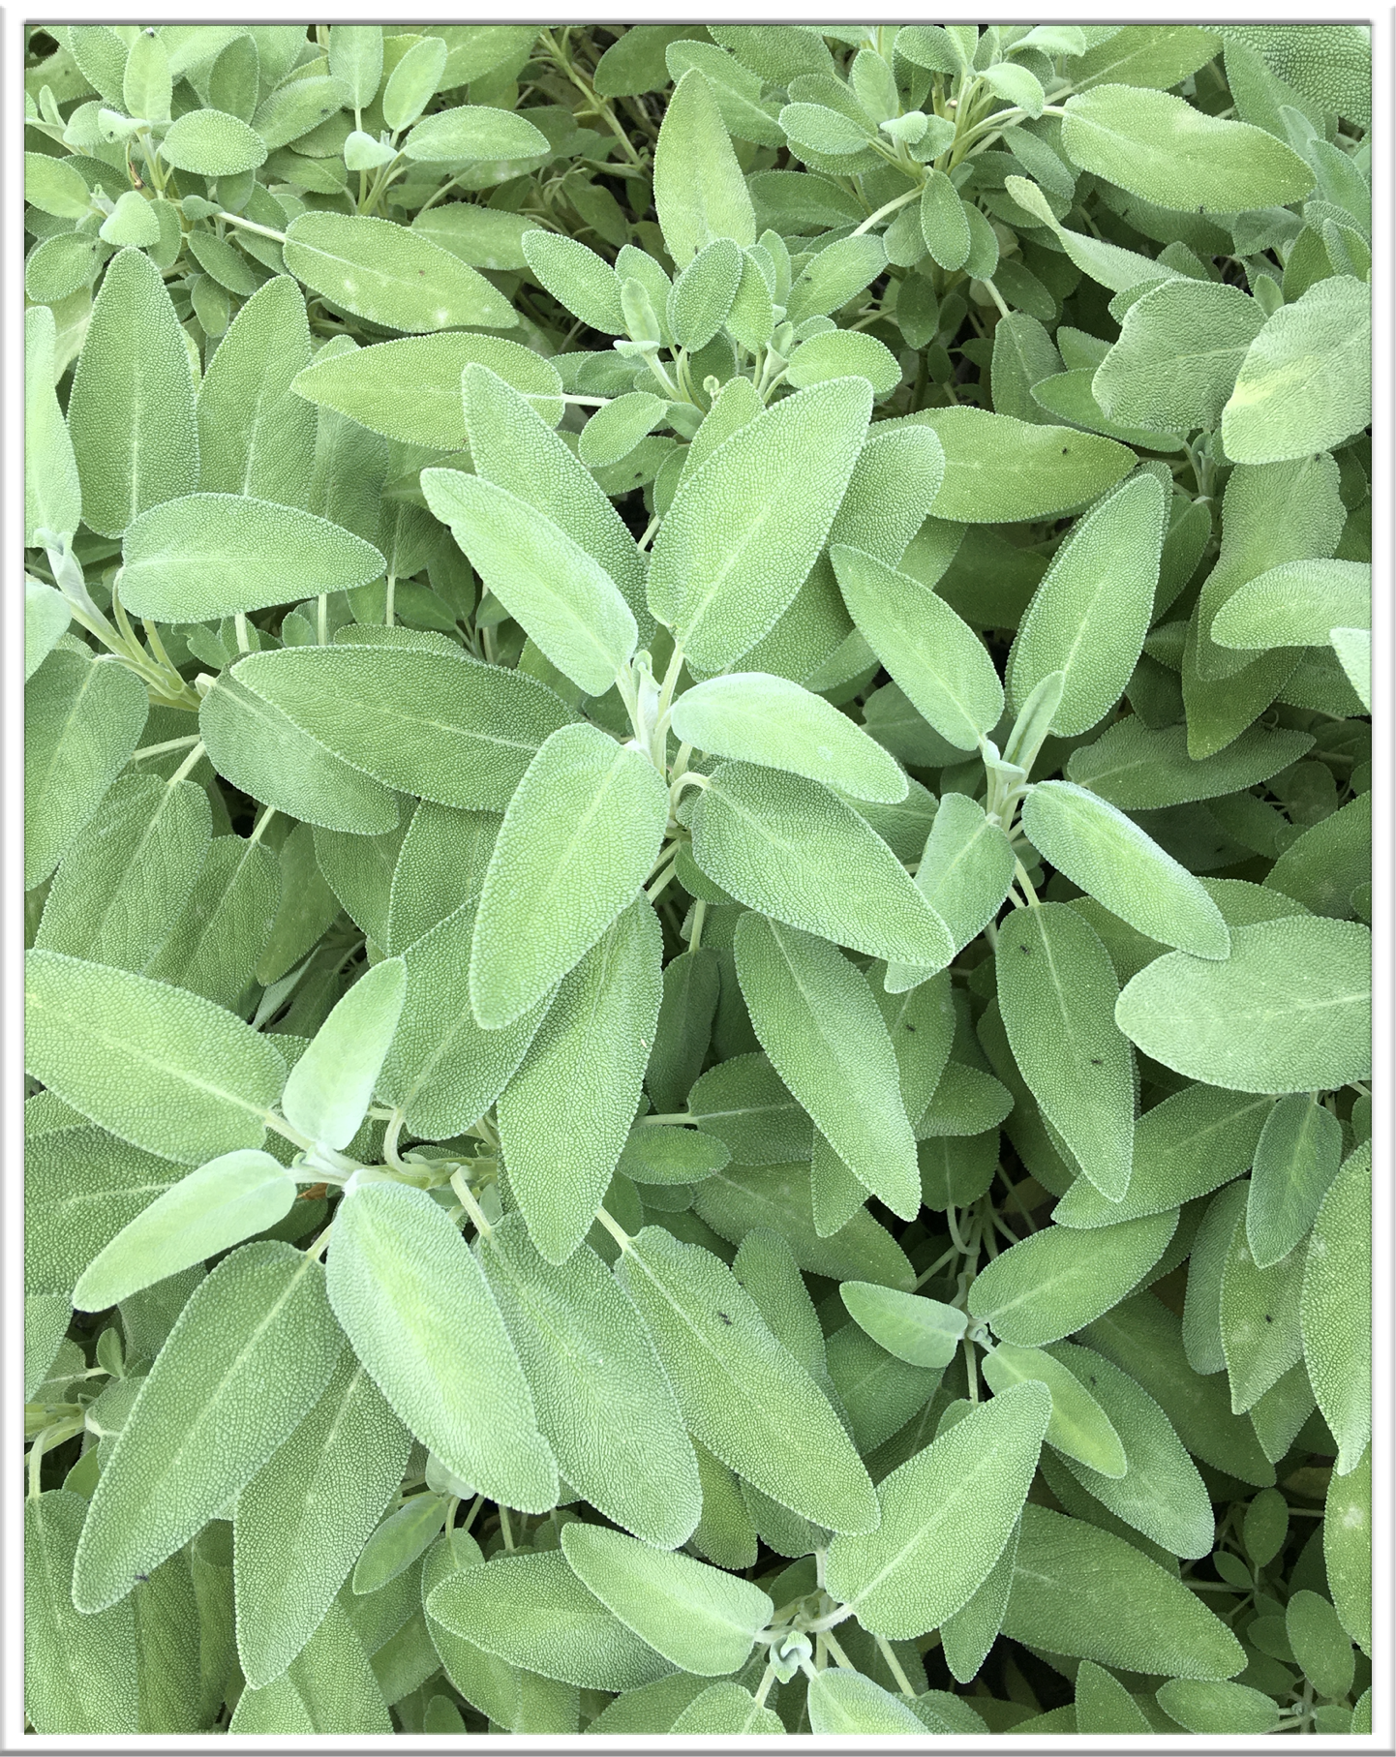
PROJECTS FOR UA RECONSTRUCTION Upcoming Projects/ Activated Carbons/Medicinal Plants/Honey/
Moreover, we have developed a specific programme for
Medicinal Herbes, Plants, Activated Carbons directly from the Carpathian Forestry.
The technology used in order to make the final “dried” product ready for selling is : cogeneration or renewable energy
And finally, we have already developed a Nursery Programme for Reforestation on behalf of the Administration of the Region.

Slide 6
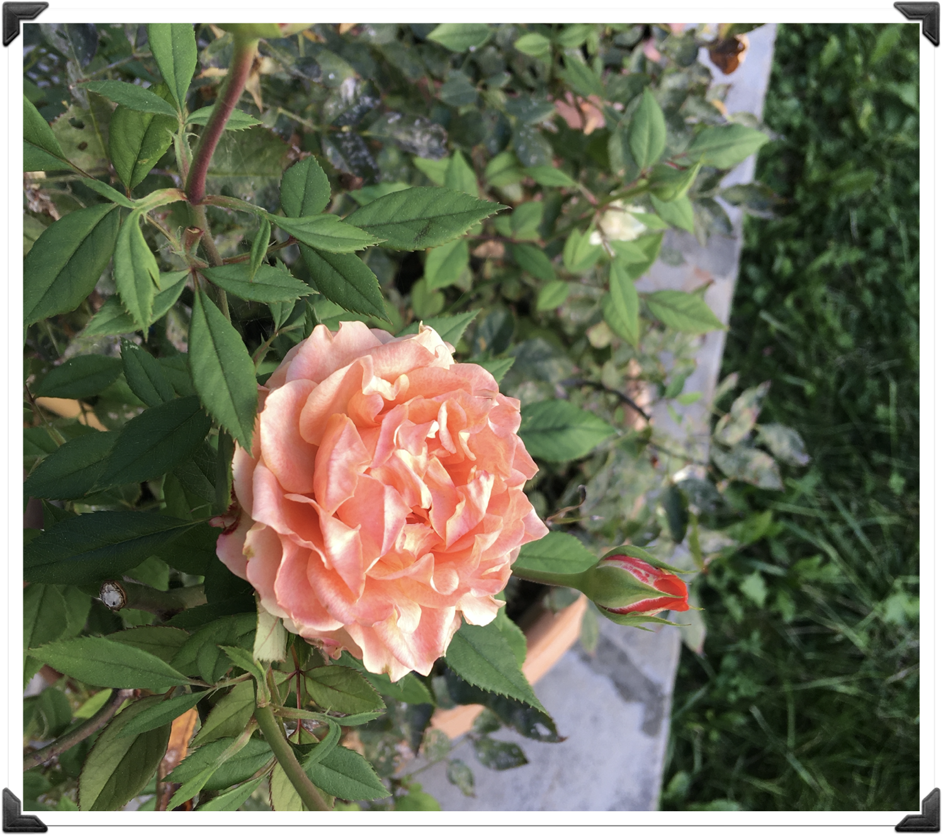
Examples of Herbs available and already sold to European Market
Rosehip berries whole dried – Elderberry whole dried - Elderberry whole dried ORGANIC –Rowanberry whole dried –Elderflower whole or rubbed –Rosehip seeds –Rosehip mix (40% shells, 60% seeds) –Wild garlic dried leaves –Wild garlic ORGANIC –Milk thistle (silymarin 3,8) –Cornflower leaves –Calamus root -Frangula bark -Hawthorn flower and leaves- Elderflower- Birch leaves-Red fruits -Honey - Propolis -Arnica- Different products-Essence for Parfumerie and Cosmetic Industry.

Slide 7
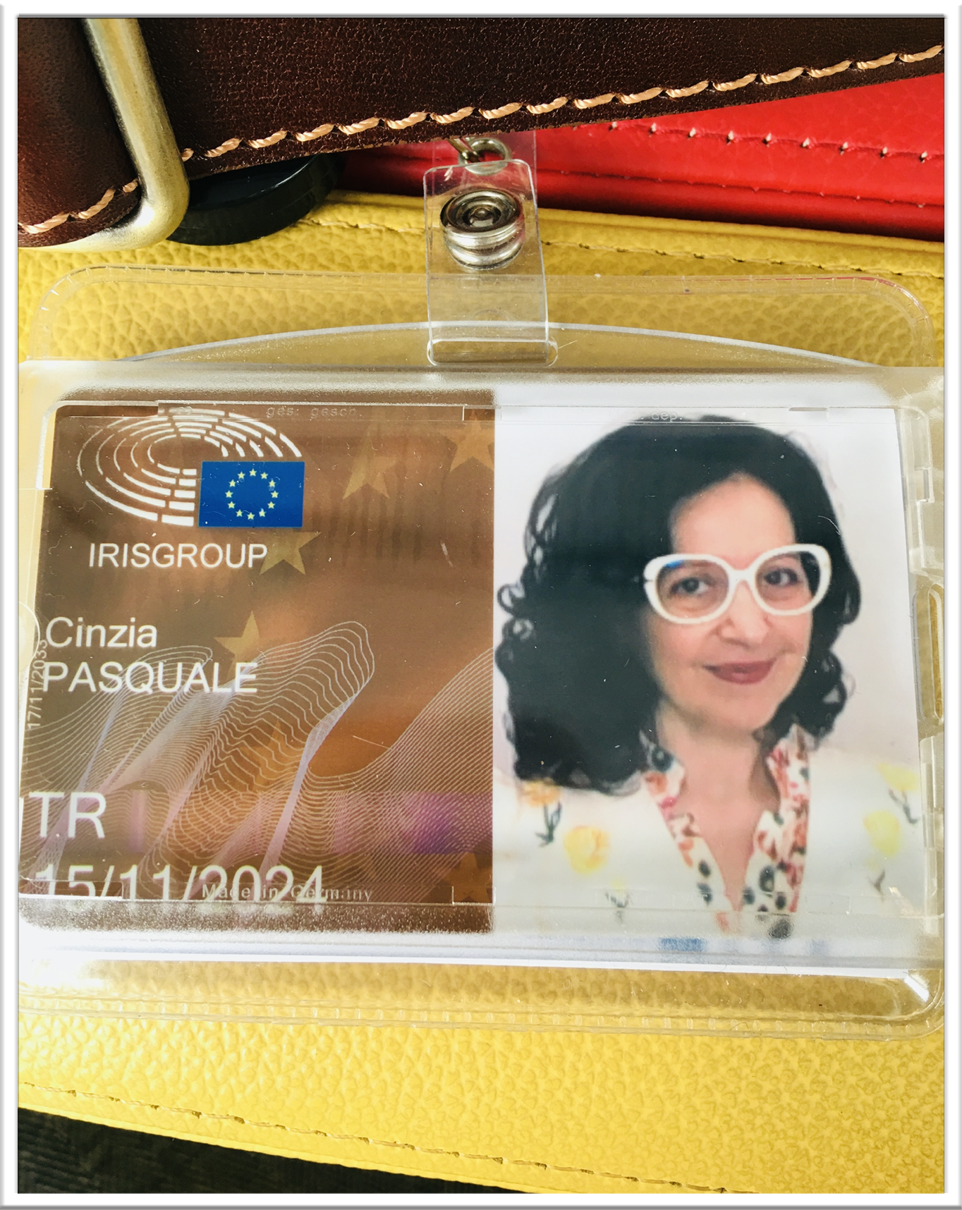
International Office in Brussels
PASCALE-PROJECTS is representing industries registered in Transparency Register at the European Parliament with the Identification number: 584565048247-47 since 2022
PASCALE-PROJECTS has been an active contributor of the EU-UKRAINE Solidarity Lanes, initiative created and supported by the European Commission for Ukrainian industries-stakeholders.
https://eu-solidarity-ukraine.ec.europa.eu/eu-assistance-ukraine/eu-ukraine-solidarity-lanes_en

Slide 8
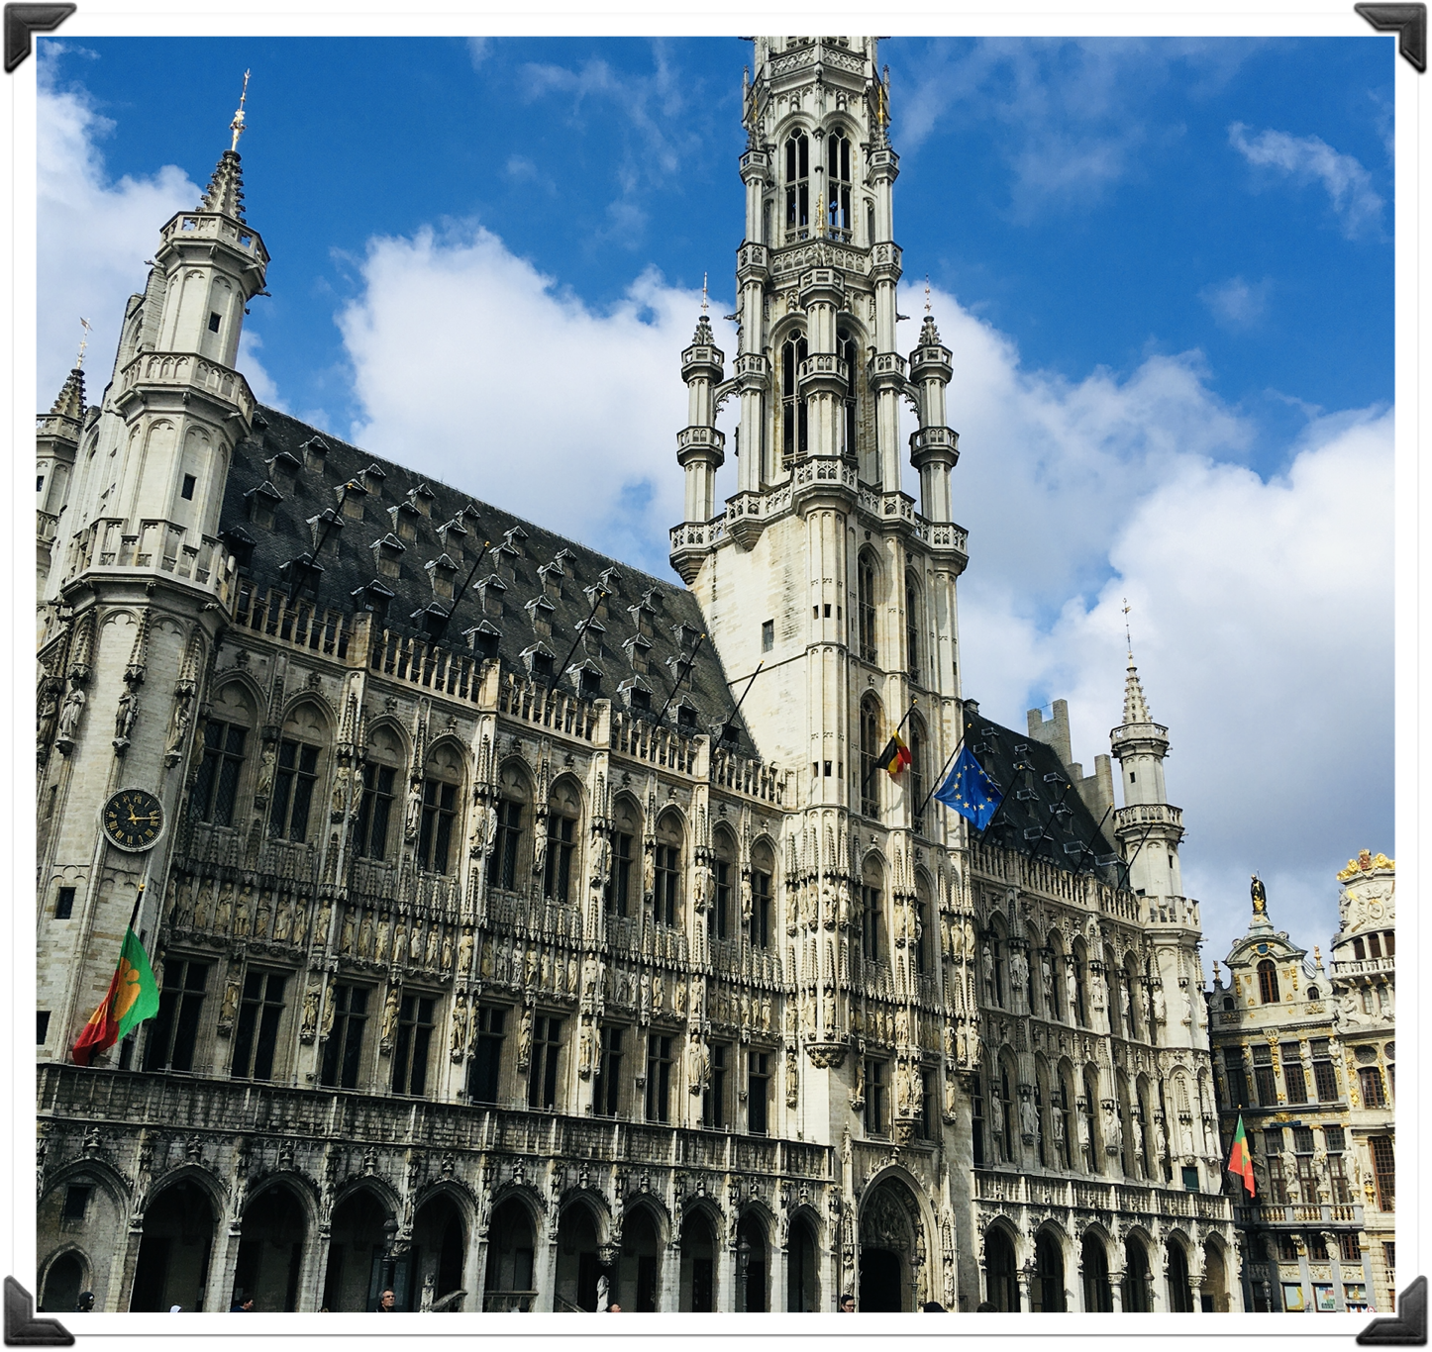
CONTACT US
For communication:
BRUSSELS OFFICE
1150 Brussels-Metro Stockel
Ms.Cinzia Pasquale
https://pascale-projects.com
cinzia.irisgroup@gmail.com
mob: +32(0) 474 651533

